Slide 1


TD Lab
BET350 Design Challenge

Slide 2
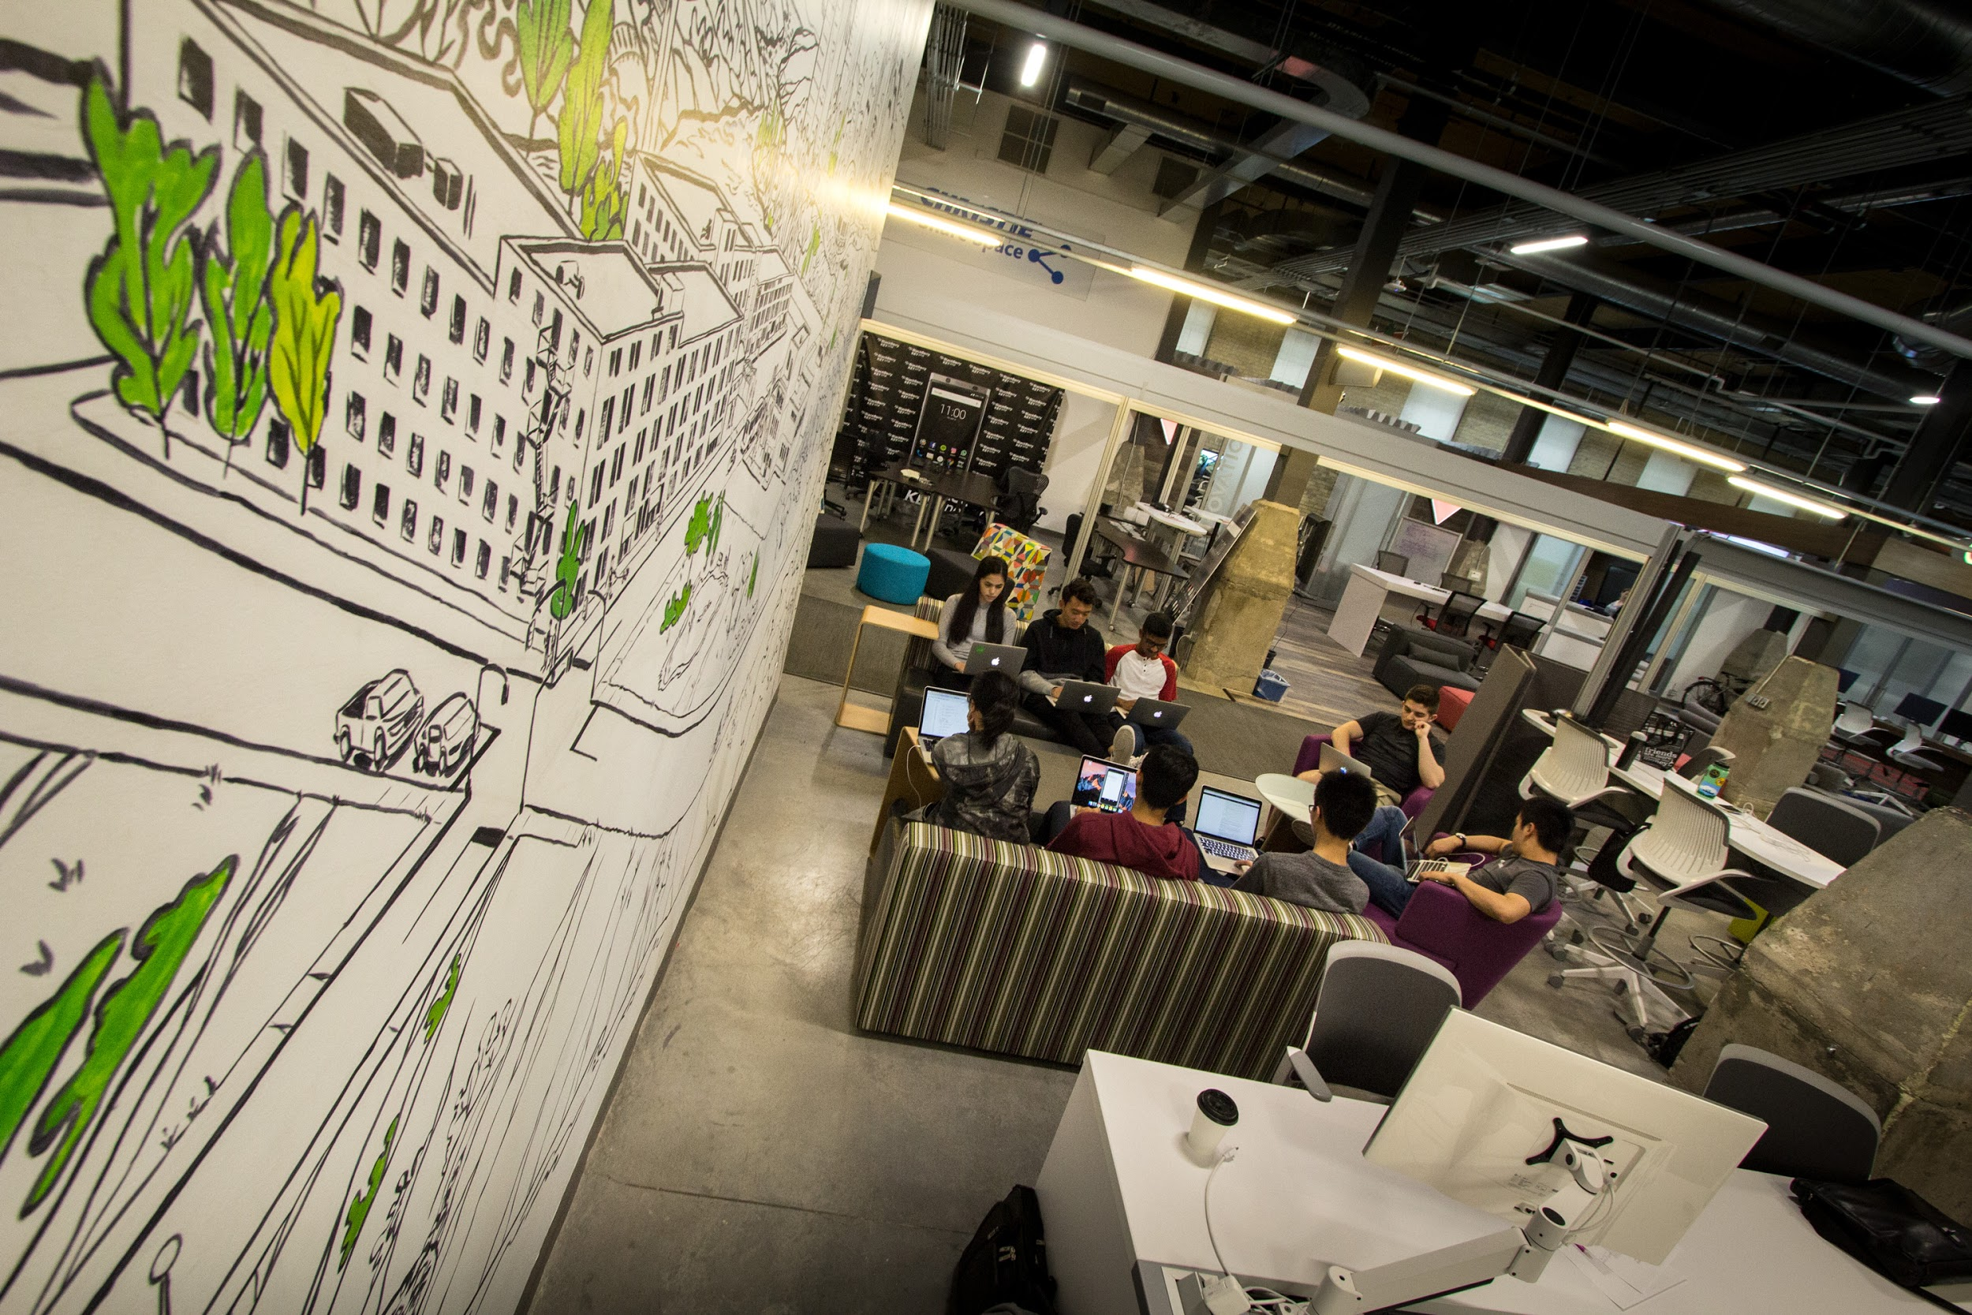

TD Lab
As a part of TD Bank Financial Group's Enterprise Innovation Team, TD Lab aims to change the way customers experience banking.
Who are we?
Located in the Communitech Hub, in Kitchener-Waterloo, we provide TD with a unique channel to experiment with emerging technology and innovate on new customer experiences
Our focus has been on pioneering a corporate innovation model that develops ideas centered on solving key customer problems
Through a rapid cycle of ideation, design, prototyping and validation, insights are discovered and modern banking concepts are revealed

Slide 3
TD Lab Large institutions like the banks are finding themselves needing to focus: building trust and being transparent with this generation, and finding new and creative ways to earn their loyalty.
Key characteristics of Generation Z
They are gritty, driven, entrepreneurial and self-starters – motivated to be different and have an impact in the world
They are already shaping the future of learning, work and more
They are altruistic with their worldview, which includes a lack of trust in large institutions
To rise to the challenge, a theme-based approach is necessary to better understand how TD can define this demographic's banking experience.
Managing Money Budgeting, Planning Daily Spending Reserves for Growth Loyalty, Rewards, Perks | Managing Aspirations Post-Secondary Education Career, Entrepreneurship Identity, Values Community Impact | Managing Lifestyle Housing, Urbanization Social Hobbies, Events Travel

Slide 4
TD Lab
With the goal of addressing generational needs of students, TD Lab is looking to UW's BET350 class to identify how we can accomplish this objective.
Design Challenge:
How might TD better establish a value-based relationship with Generation Z that is grounded in trust and reciprocity?
If TD was to launch one new product/service this year to serve the needs and aspirations of Generation Z, what might it be?
How would it compliment, yet differentiate, itself from typical, existing banking experiences offered today?
What would TD's ideal customer looks like for such an offering?
What would this customer define as value?
What would they expect in return for being a customer (rewards, advice, etc.)?

